Slide 1
Tell it to the coming generation
Reflections on Psalm 78
Thoughts and Prayers
Reflections on
How to
Pray for Our Pastor

Slide 2
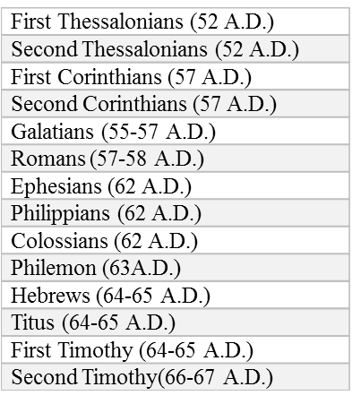
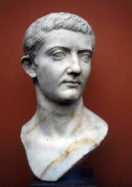
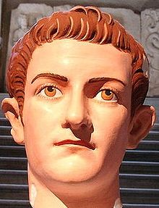
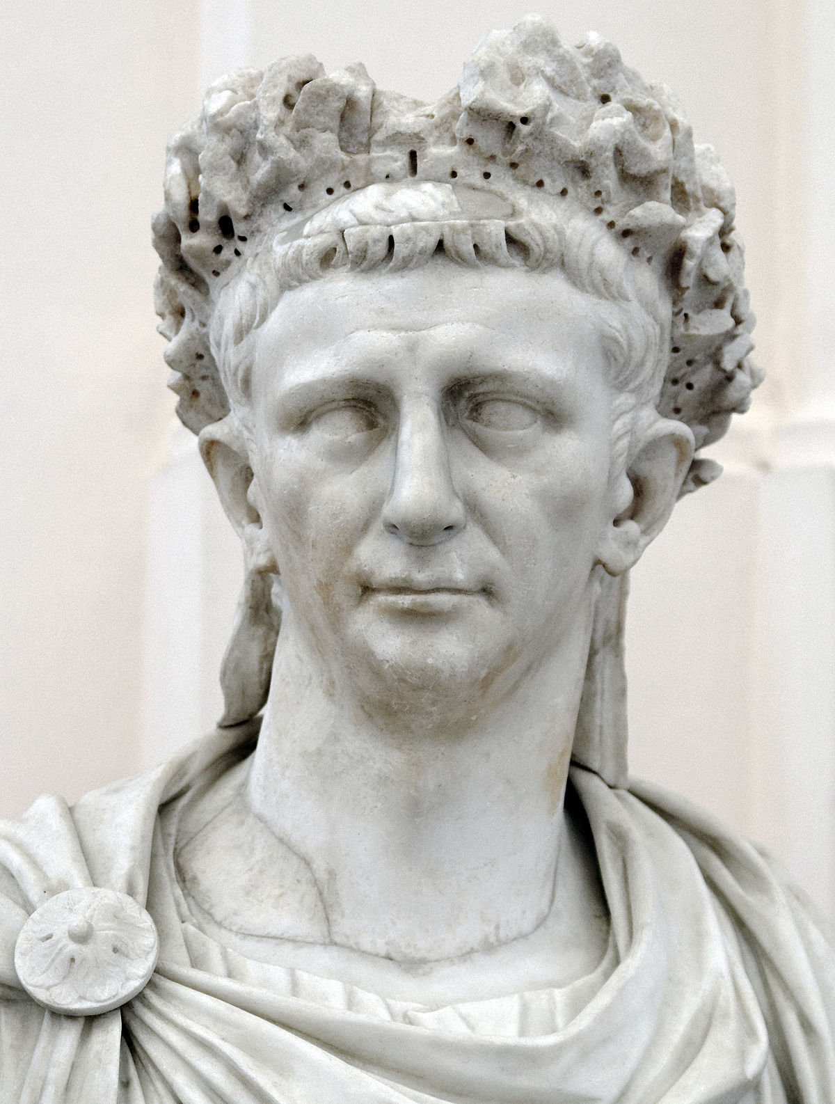
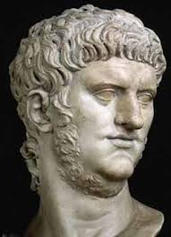
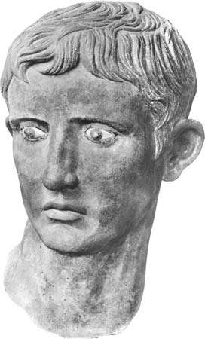
Paul and the Romans in Historical Context
Who was Paul?
How did Paul know Jesus?
Why did the Romans matter to Paul?
What was the purpose of the letter to the Romans?
Paul’s Post-imprisonment Missions 63-67 A.D.
Josephus surrenders to Rome A.D. 67
Paul Imprisoned in Rome 61-63 A.D.
Paul travels to Rome 60-61 A.D.
Paul Re-arrested/Death A.D. 67
Paul Imprisoned in Judea 58-60 A.D.
Nero commits suicide A.D. 68
Jewish Revolt in Rome 66 A.D.
Paul’s 1st Mission Trip A.D. 45-47
Paul’s 3rd Mission Trip A.D. 54-58
Temple destroyed A.D. 70
Council of Jerusalem A.D. 50-51
Jesus death/resurrection A.D. 30
Paul’s 2nd Mission Trip A.D. 51-53
John the Baptist death 28 A.D.
Claudius expels Jews A.D. 49
Jesus born 5-6 B.C.
Paul meets Jesus A.D. 35
Saul born 5 A.D.
Stephen death A.D. 32
Caesar Augustus
(Octavian; 31 B.C.)
Caesar Tiberius
(14 A.D.)
Caligula (37 A.D.)
Claudius
(41 A.D.)
Nero
(54 A.D.)

Slide 3
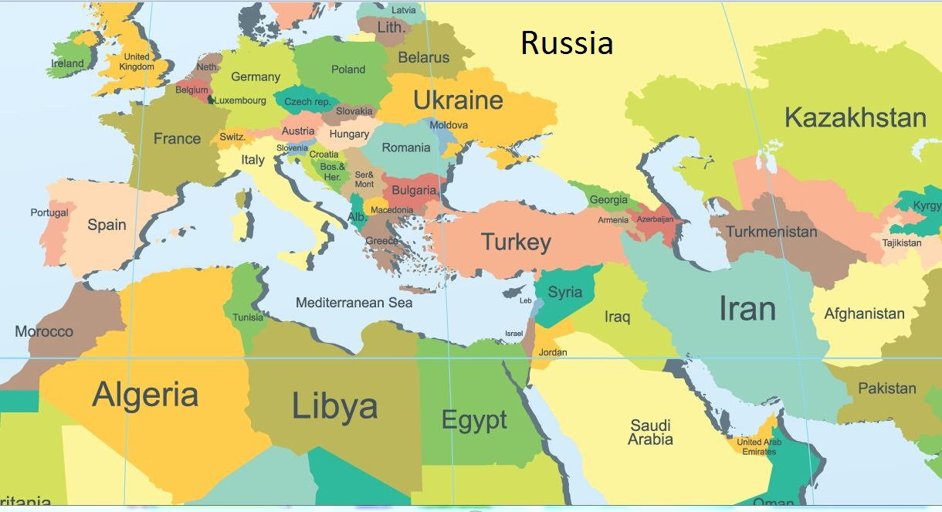

Slide 4
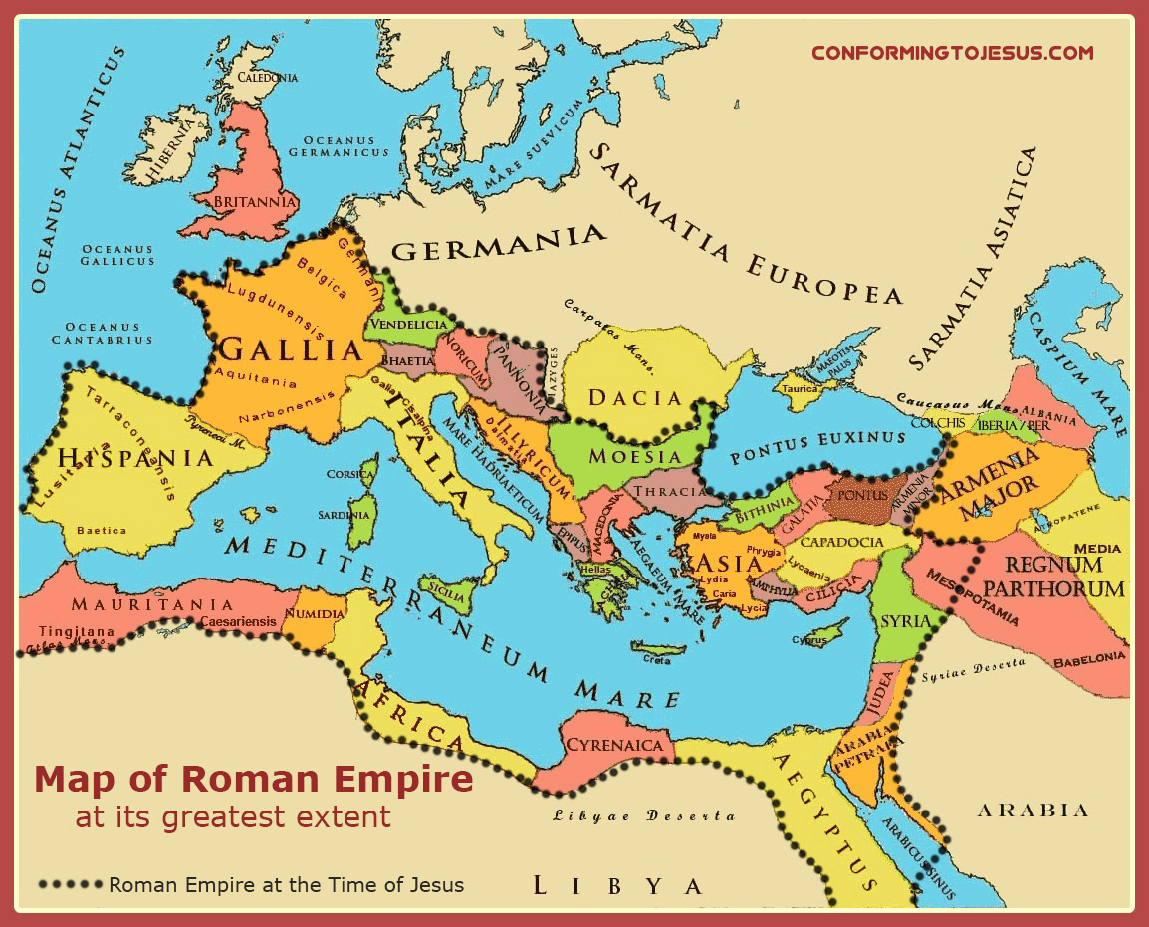

Slide 5
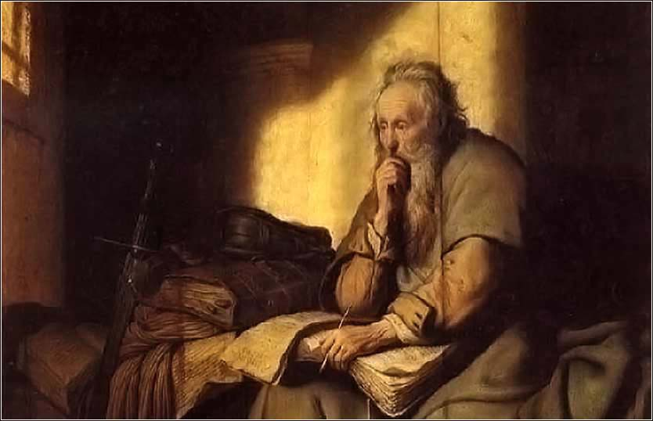
Paul Asked for Prayer Many Times
1 Thessalonians 5:25), “Brethren, pray for us.”
2 Thessalonians 3:1-2 pray that the word of the Lord would spread rapidly and be glorified and that he would be rescued from evil men.
Philippians 1:19-20 pray that he would be delivered from prison, but that whatever the outcome, Christ would be exalted through him
Ephesians 6:19-20 and Colossians 4:3-4, pray for opportunities to preach the gospel and that he would do so with boldness and clarity.
2 Corinthians 1:9-11, pray that God would deliver him from the peril of death.

Slide 6
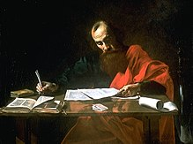
Romans 15:30-32 New International Version (NIV)
³⁰ I urge you, brothers and sisters, by our Lord Jesus Christ and by the love of the Spirit, to join me in my struggle by praying to God for me.
³¹ Pray that I may be kept safe from the unbelievers in Judea and that the contribution I take to Jerusalem may be favorably received by the Lord’s people there,
³² so that I may come to you with joy, by God’s will, and in your company be refreshed.
Blaffer Foundation Collection, Houston, TX
Public Domain
File:File"-Saint Paul Writing His Epistles" by Valentin de Boulogne.jpg
Created: between circa 1618 and circa 1620

Slide 7
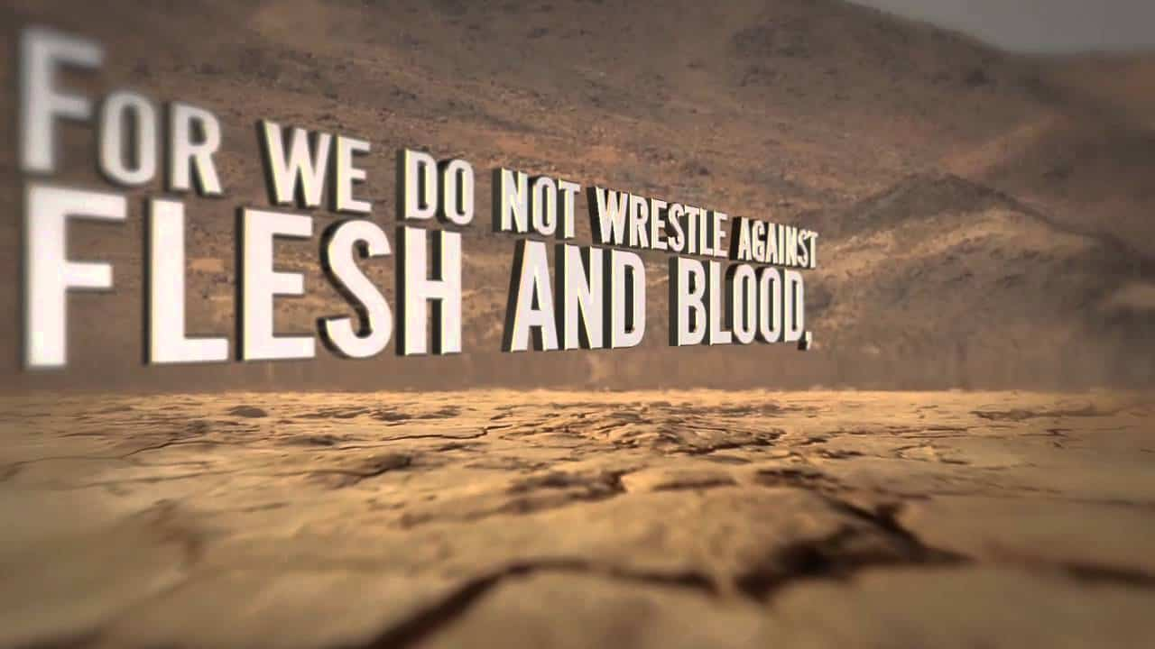
Spiritual warfare
³⁰ I urge you, brothers and sisters, by our Lord Jesus Christ and by the love of the Spirit, to join me in my struggle by praying to God for me.
Image from The Front Porch
³¹ Pray that I may be kept safe from the unbelievers in Judea and that the contribution I take to Jerusalem may be favorably received by the Lord’s people there,
³² so that I may come to you with joy, by God’s will, and in your company be refreshed.

Slide 8
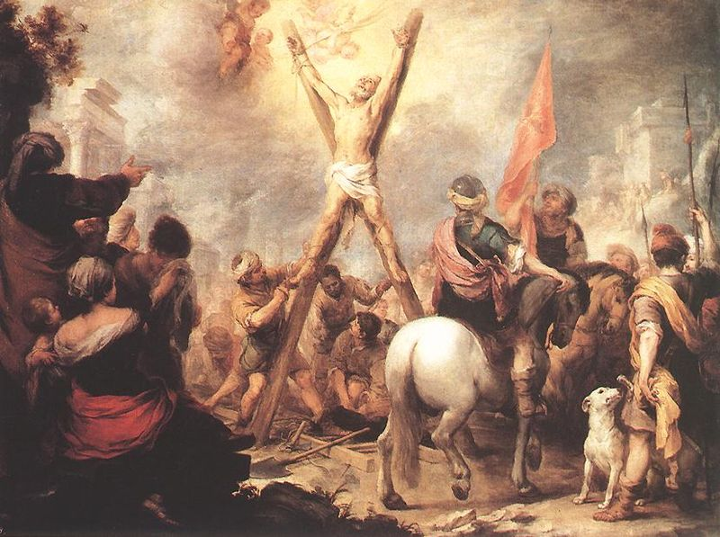
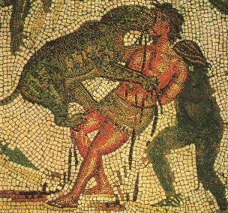
Deliverance from Unbelievers
³⁰ I urge you, brothers and sisters, by our Lord Jesus Christ and by the love of the Spirit, to join me in my struggle by praying to God for me.
³¹ Pray that I may be kept safe from the unbelievers in Judea and that the contribution I take to Jerusalem may be favorably received by the Lord’s people there,
³² so that I may come to you with joy, by God’s will, and in your company be refreshed.

Slide 9
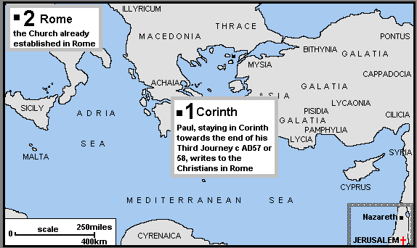
Ministry to be well-received
³⁰ I urge you, brothers and sisters, by our Lord Jesus Christ and by the love of the Spirit, to join me in my struggle by praying to God for me.
³¹ Pray that I may be kept safe from the unbelievers in Judea and that the contribution I take to Jerusalem may be favorably received by the Lord’s people there,
³² so that I may come to you with joy, by God’s will, and in your company be refreshed.

Slide 10
Joy in his Ministry
³⁰ I urge you, brothers and sisters, by our Lord Jesus Christ and by the love of the Spirit, to join me in my struggle by praying to God for me.
³¹ Pray that I may be kept safe from the unbelievers in Judea and that the contribution I take to Jerusalem may be favorably received by the Lord’s people there,
³² so that I may come to you with joy, by God’s will, and in your company be refreshed.

Slide 11
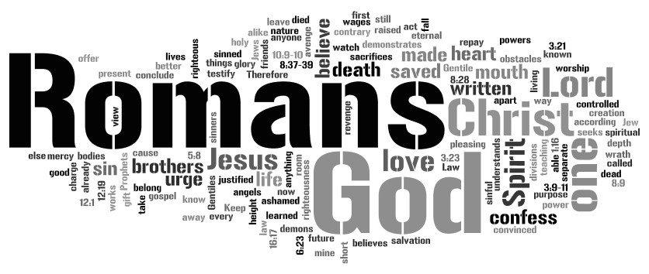
To be in the middle of God’s will
³⁰ I urge you, brothers and sisters, by our Lord Jesus Christ and by the love of the Spirit, to join me in my struggle by praying to God for me.
³¹ Pray that I may be kept safe from the unbelievers in Judea and that the contribution I take to Jerusalem may be favorably received by the Lord’s people there,
³² so that I may come to you with joy, by God’s will, and in your company be refreshed.

Slide 12
To be refreshed
³⁰ I urge you, brothers and sisters, by our Lord Jesus Christ and by the love of the Spirit, to join me in my struggle by praying to God for me.
³¹ Pray that I may be kept safe from the unbelievers in Judea and that the contribution I take to Jerusalem may be favorably received by the Lord’s people there,
³² so that I may come to you with joy, by God’s will, and in your company be refreshed.

Slide 13
So, what can you do?
Pray for your pastor!
This is Spiritual Warfare!
Pray against those who would tear him down.
Pray that he is encouraged and support him as a whole person.
Think of his wife. Think of her prayer needs
Think of each child and their individual fears, desires, and interests.
Pray that he would have joy – help facilitate joy.
Give him time and space to be refreshed.
Grab the yoke and get moving!

