Slide 1
Of the Father’s Love Begotten
Songs of Incarnation
The Union Church of Guatemala
12-16-18

Slide 2
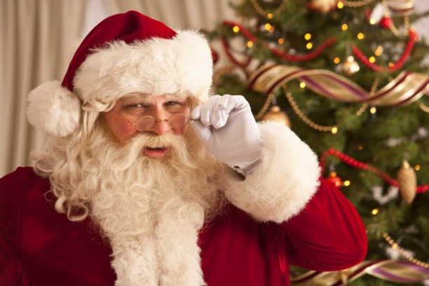
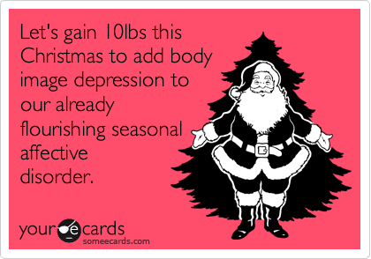
A Necessary Reminder – Our culture pulls us away

Slide 3
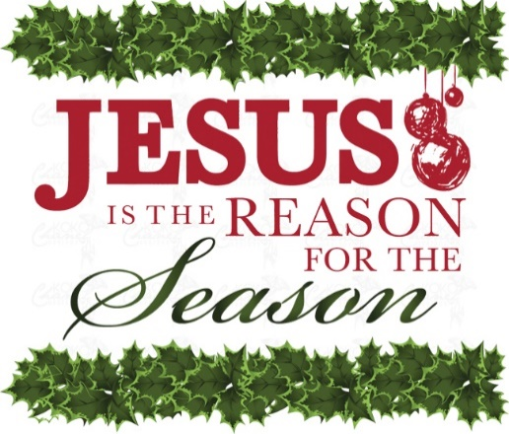
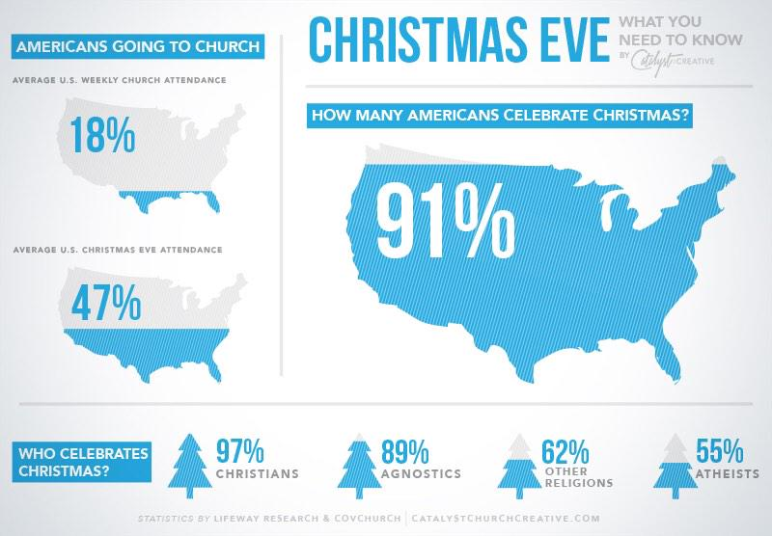
A Necessary Reminder – Our Evangelical sub culture pulls us away

Slide 4
Songs of Incarnation – the Who of Christmas

Slide 5
Of the Father’s Love Begotten
A musical picture of the Biblical Jesus

Slide 6
He the Source, the Ending he
Colossians 1:16-17
Hebrews 1:2
Revelation 1:17-18

Slide 7
Bare the Saviour of our race
Hebrews 5:7-10
Hebrews 7:23-25

Slide 8
Powers, dominions, bow before Him, And extol our God and King.
John 20:28
Philippians 2:9-10

Slide 9
Whom the Scriptures of the prophets, Promised in their faithful word.
Proverbs 13:12
Isaiah 6:8-13
Isaiah 11:1-5
Isaiah 9:1-7

Slide 10
Christ, to Thee, with God the Father, And, O Holy Ghost, to Thee Hymn and chant and high thanksgiving And unending praises be,
Galatians 3:13-14 / 2 Corinthians 13:14 / Psalm 150

